Slide 1
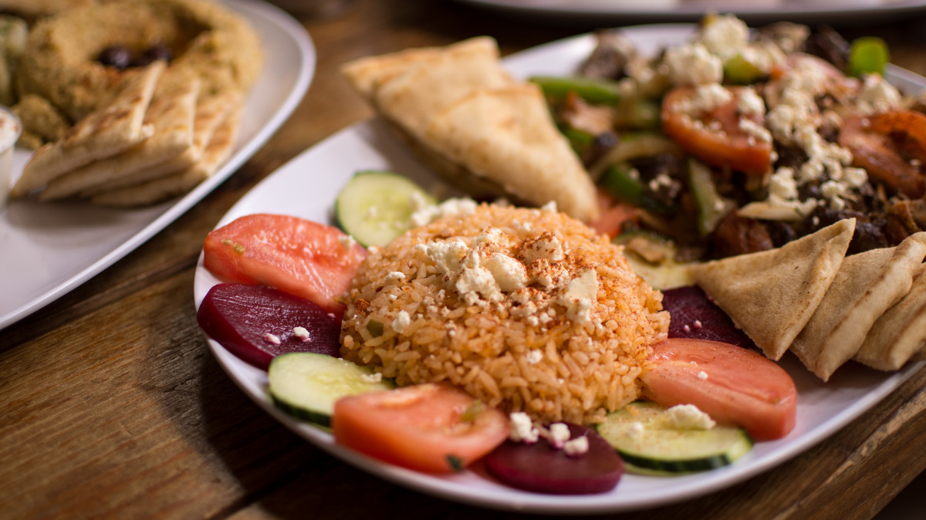
Food fashion ltd.
Good food good life

Slide 2

WELCOME TO MY PRESENTATION
Food fashion ltd.
Nusrat Jahan lima
Batch 21
Department of botany
6th oct 2024

Slide 3
Introduction
Food is any substance consumed by an organism for nutritional support. . As food is fundamental need for human . so, we try to provide quality food for those working people who doesn’t have no time for cooking.so, we founded FOOD FASHION LTD. in 2024 . Set out itself to be a leading contract food supply. We have branched in major towns like Barisal ,Khulna ,Madaripur .

Slide 4
MISSION
Serve good food
Maintain quality
Client satisfaction

Slide 5
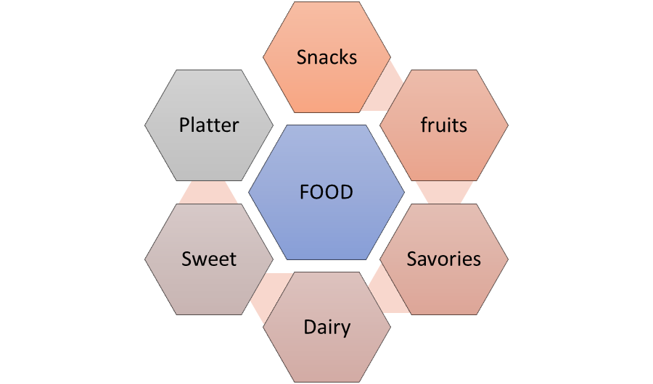
Categories

Slide 6

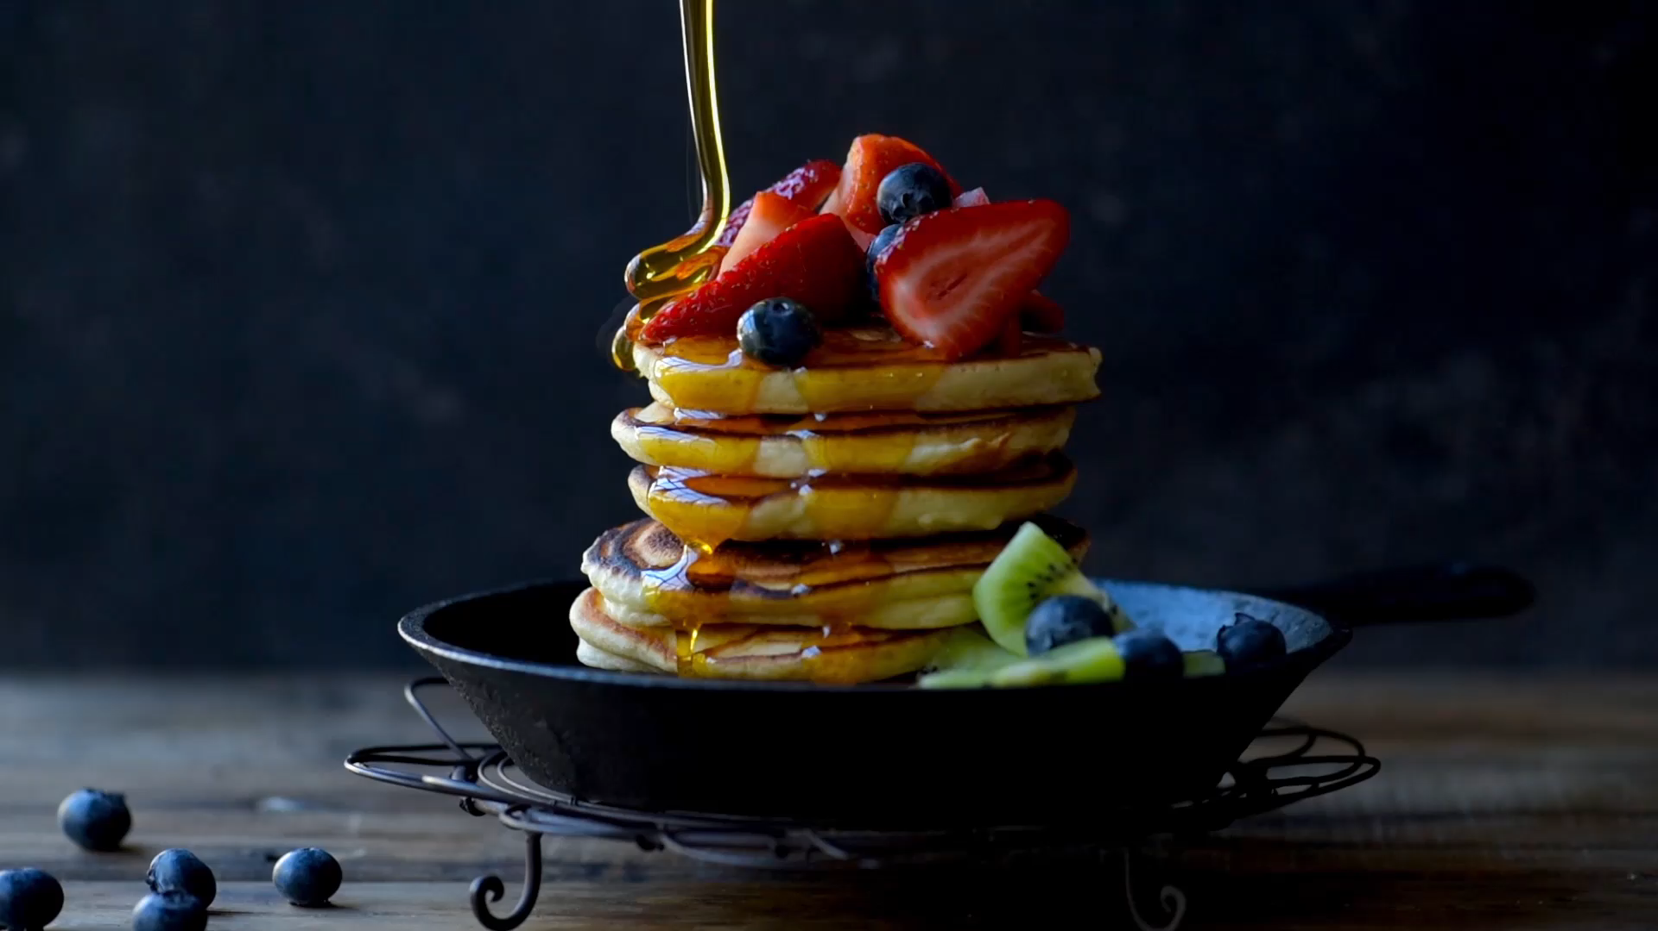
Garnishing makes food more delicious

Slide 7
To save your time and get good food place order your food from our company.
THANK YOU

